Slide 1
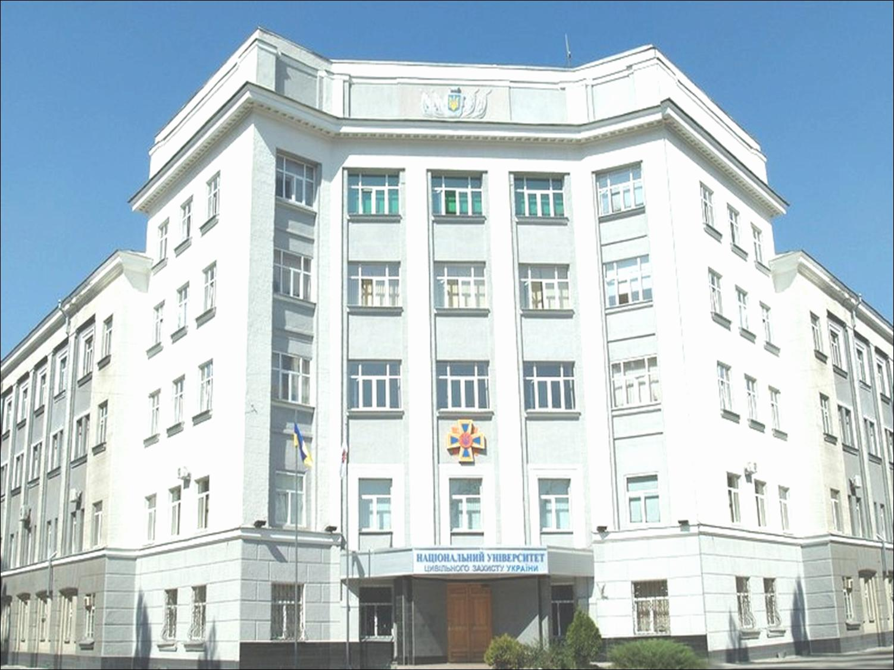
National University of Civil Defence of Ukraine
Topic of the report:
Development of a Mobile Application for Calculation of Fire Risks in the Android Studio Environment
Authors: Svitlana Bordiuzhenko, Oleksandr Sobol,
Olena Liashevska, Dimiter Velev
Reporter – Svitlana Bordiuzhenko, PhD.

Slide 2
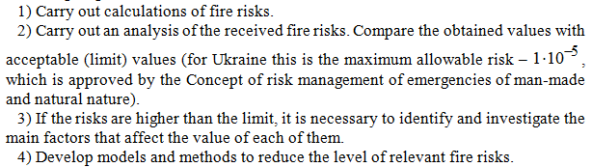
To ensure human safety, namely the reduction of fire risk levels, it is necessary to go through the following stages:
2

Slide 3

Paper object
In this research, it is necessary to develop software for the identification and analysis of integral fire risk
Integral fire risk :
(1)
3

Slide 4
Dynamics of integral fire risk R₃ during 2010–2020 years
4

Slide 5
Home page of the mobile application
5

Slide 6
Adding information about the region being analyzed
6

Slide 7
Form for filling in information about the research region
7

Slide 8
Analysis type selection window
8

Slide 9
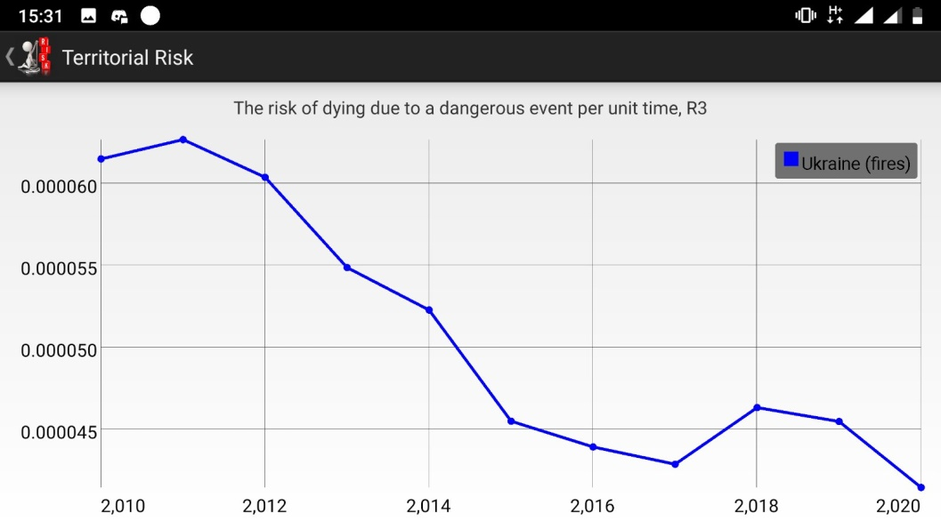
Dynamics of integral fire risk R₃ during 2010–2020 years with using Android application "Territorial risk", 1/year
9

Slide 10
THANK YOU FOR LISTENING!!!
My email address: kravtsiv1992@gmail.com

